Slide 1


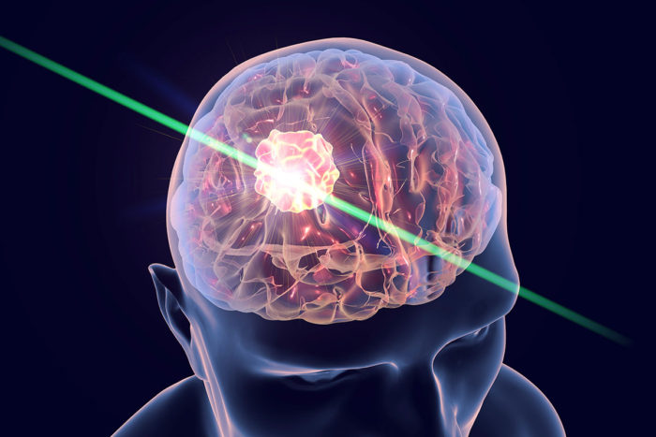
Medical physics first year
L14 Laser In Medicine
By Assistants professor
Dr.Ghania Salim Al-Thaher
Physiology Department
College of Medicine
University of Basrah

Slide 2
Laser In Medicine
Objectives
By the end of this section, the student learning about :
What is the laser?
Characteristics of Laser Light
Lasers in Medicine
Interaction of laser with tissues
Important parameters
Applications of laser in medicine

Slide 3
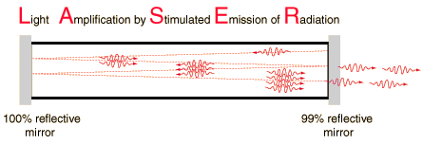
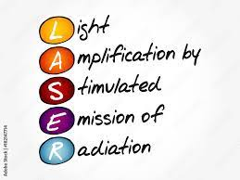
What is the laser?
Stimulated Emission
Necessary for the operation of a laser.
Laser Spectrum
Lasers operate in the ultraviolet, visible, near infrared and far infrared regions of the spectrum.

Slide 4
Characteristics of Laser Light
MONOCHROMATIC
DIRECTIONAL
COHERENT
The combination of these three properties (monochromatic, directional and coherence) makes laser light focus 100 times better than ordinary light.

Slide 5
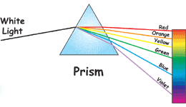
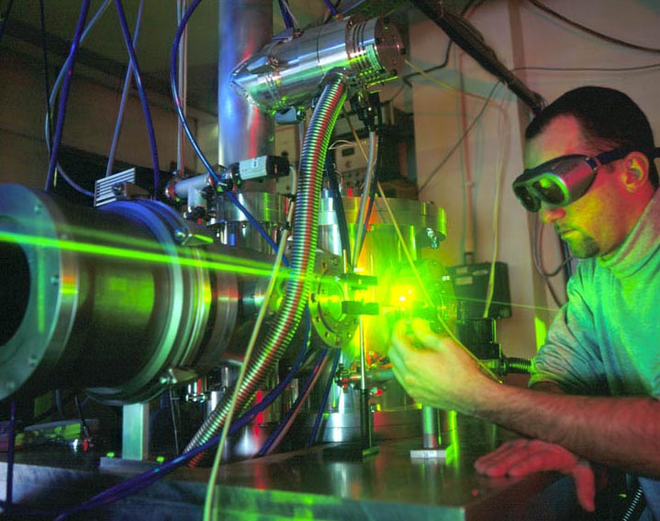
The monochromatic
Property of laser light means it is all one wavelength.
Concentrate in a narrow range of wavelengths (one specific color).
Laser source
Ordinary source

Slide 6
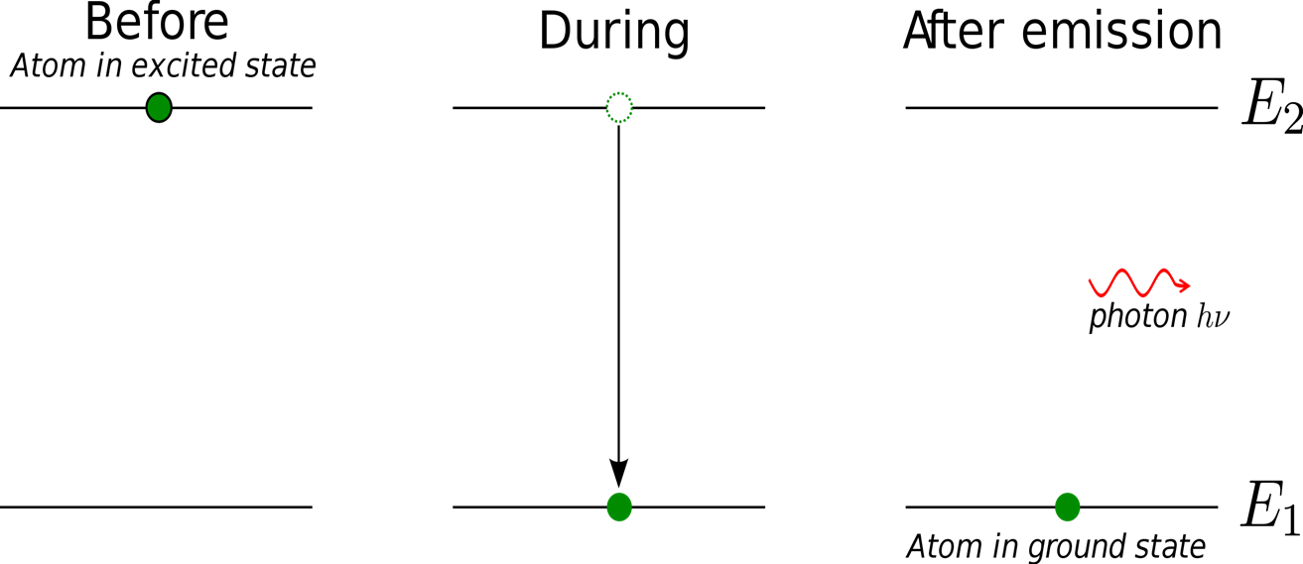
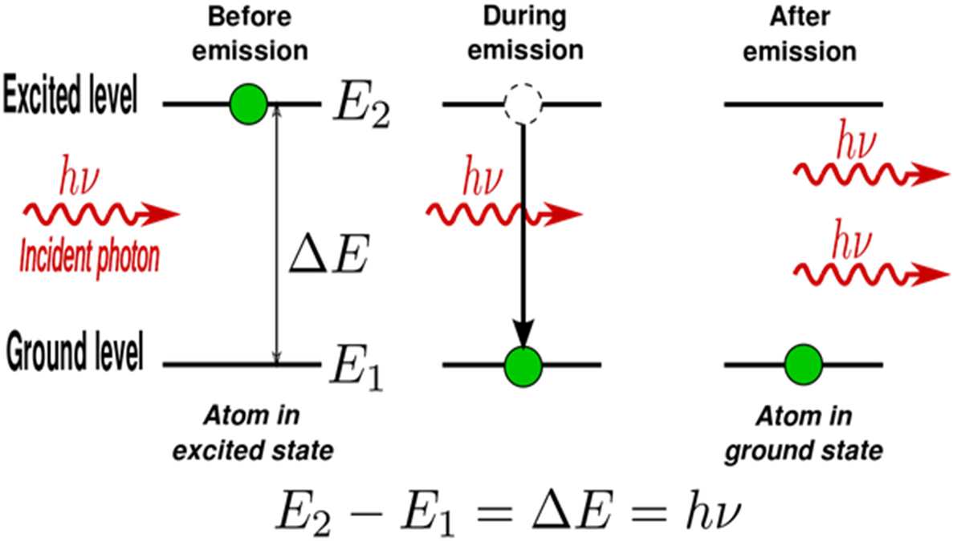
Directional
Bulbs Light vs. Laser Light
Light from bulbs are due to spontaneous emission
Laser light are due to Stimulated Emission

Slide 7
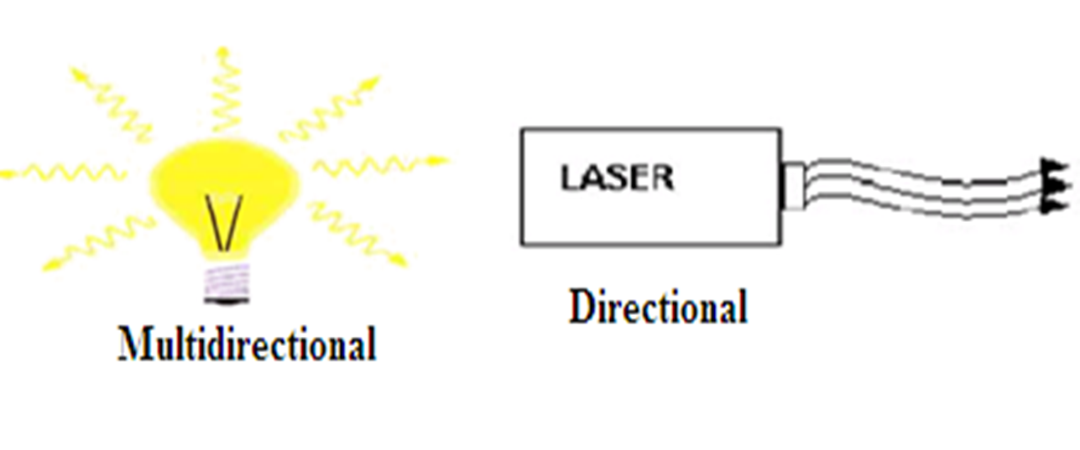
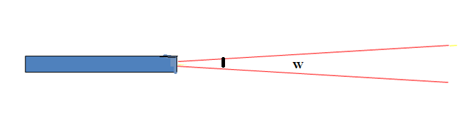
Light from bulbs are multidirectional
Laser are one directional
The directional λ of laser, a very tight beam which is very strong and concentrated.
Means that the beam spreads very slowly.
W is the waist, or the minimum width of the beam inside the laser cavity - NOT ZERO!

Slide 8
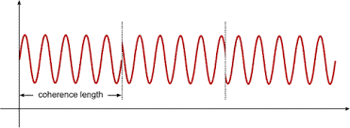
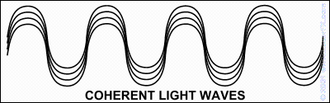
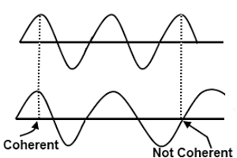
Coherence
All the emitted photons bear a constant phase relationship with each other in both time and phase
Coherence
Incoherent

Slide 9
Characteristics of Lasers in Medicine
The characteristics of laser light are defined by
Wavelength
Pulsed or continuous wave operation
Average power.
Primary use of laser: to deliver energy to tissue.
  1.The laser wavelength used should be strongly absorbed by tissue
  2. Good absorption in the blue-green region of the spectrum (400-600 nm) it is better than the long wavelength (700 nm)
  3.Less efficient in red/infrared

Slide 10
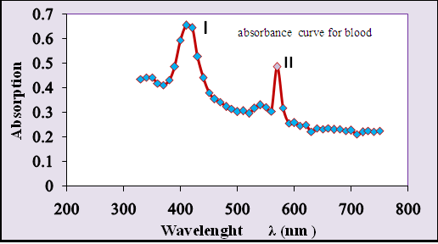

Slide 11
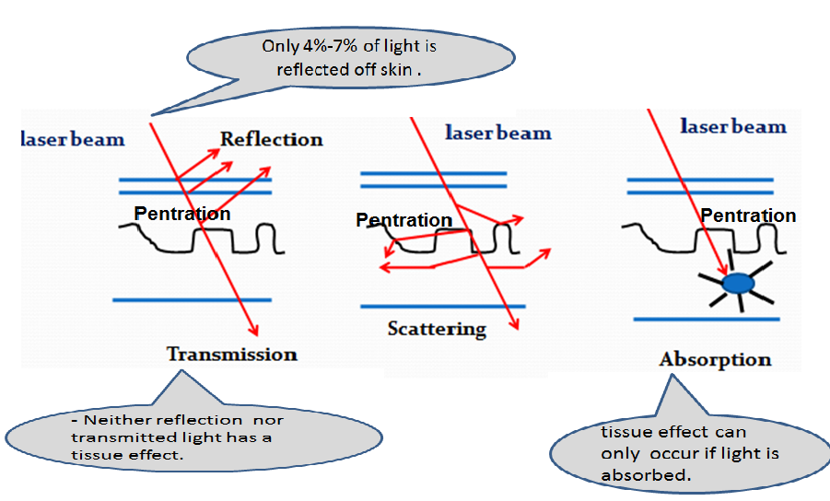
Interaction of laser with tissues

Slide 12
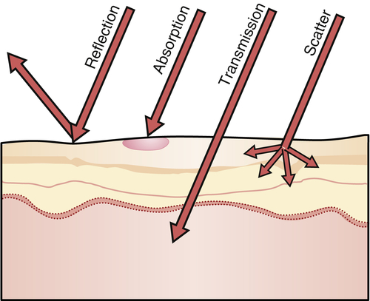
Therefore the tissue effect can only occur if light absorbed
Laser energy directed at human tissue causes a rapid rise in temperature and can destroy the tissue.
The amount of damage to living tissue depends on how long the tissue is at the increased temperature

Slide 13
When laser light absorbent the following effects accrues:-

Slide 14
2- Mechanical effects
Laser cause photomechanical effect.
When pulse duration is shorter than the TRT(thermal relaxation time )(Time taken for 50% of heat energy to be conducted away from target tissue. ) of the target :
Thermos elastic
Expansion occur because of spatially localized heating
Acoustic wave damage surrounding structures

Slide 15
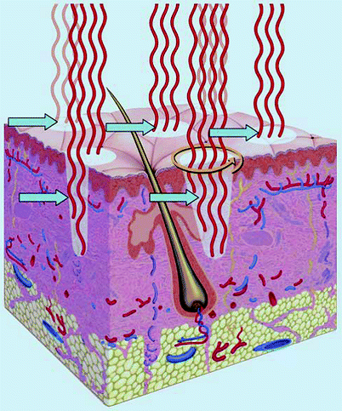
3- Selective photothermolysis effect
The concept of selective photothermolysis by choosing a wavelength absorbed by the target tissue.
It should be possible to select a pulse duration and fluency that will selectively damage the target ( chromophore in the skin (blood, melanin))without causing a change in adjacent tissues.

Slide 16
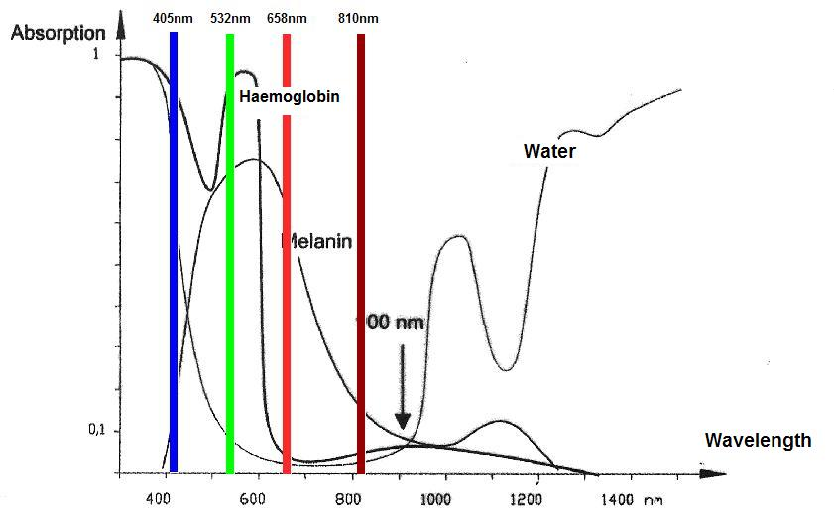
Therefore, Red lasers are used in surgery because it is not absorbed by blood

Slide 17
Primary Damage Mechanisms:
  Red/Infrared - Primarily heating
    Tissue can stand 70ºC for 1 sec, 100ºC destroys tissue.
  Blue/Green - Photochemical
    Example: 24 W/cm² 1064 nm Nd:YAG produces some heat damage to the retina.
    0.03 W/cm² 411.6 nm Ar⁺ produces the same degree of damage

Slide 18
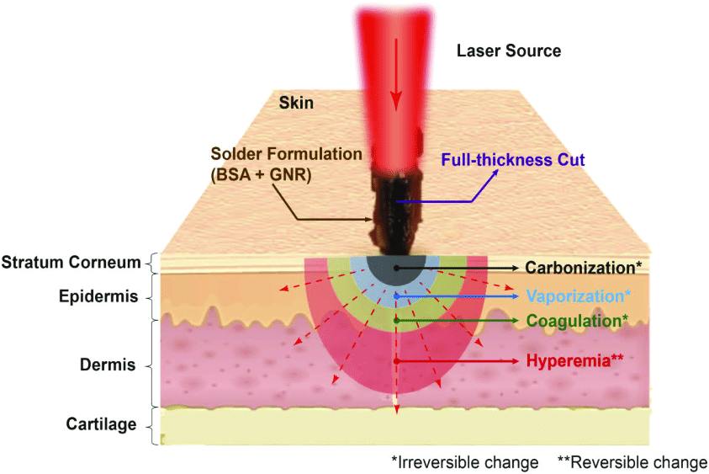
Light-tissue effects can be grouped in:
a. Photothermic Reactions:
Laser light absorbed by chromophores (Tissue elements that absorb a particular wavelength or spectrum of light energy to a high degree) in the tissue is converted into heat.

Slide 19
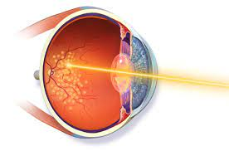
A typical application of Photothermic Reactions is:
Photocoagulation :
The laser light is absorbed by hemoglobin to stop bleeding or to seal blood vessels, the heating a blood vessel to point where the blood coagulates and blocks the vessel
In ophthalmic surgery: in eye the retina may become detached from the choroid owing to disease, injury, or degenerative changes. The laser are primarily used for photocoagulation of the retina,

Slide 20
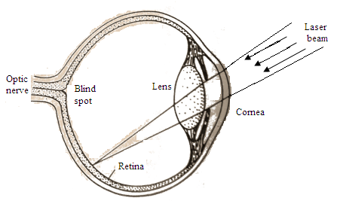
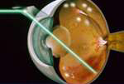
2. Thermal ablation: when laser light vaporizes tissue water for tissue cutting.
This interaction requires laser solutions that have high average power and a wavelength that matches the absorption levels of target tissue.

Slide 21
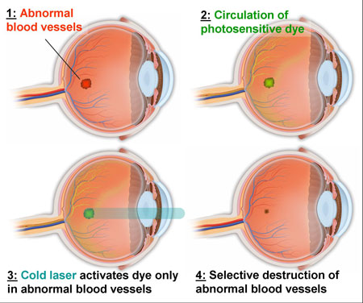
b. photochemical Reactions:
Photons absorbed by tissue molecules. Excited molecules can undergo chemical reactions.
1. Photodynamic therapy (PDT) where a photosensitive drug is administered. Using specific wavelengths enables applications such as selective photothermolysis. Tattoo removal is an example of this.
This interaction requires laser solutions that have high average power and a wavelength defined by molecule absorption.

Slide 22
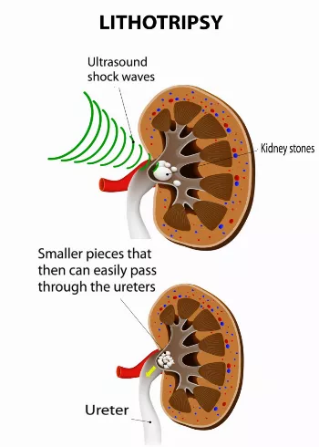
2. Photo ablation: Laser light is used to break the molecular bonds in the tissue. Key applications include
Ophthalmology where UV laser light is used for refractive surgery of the cornea,
Lithotripsy where high energy laser pulses are used to generate plasma and shock waves that can break up kidney stones.
Typical laser solutions operate in pulsed mode for high peak power and, depending on the type of tissue, have UV to NIR wavelengths

Slide 23
Laser effects on tissue depend on
- The power density of the incident beam,
-Absorption of tissues at the incident wavelength,
-Time beam is held on tissue,
- The effects of blood circulation
-Heat conduction in the affected area
Important parameters
•Optical properties of the tissue fluid
absorption & scattering coefficients
•Thermal properties of the tissue:
thermal capacity & thermal conductivity

Slide 24
Laser parameters :
Wavelength
Power density.
Exposure time.
Fluence.
Pulse duration.
Focused spot size.
Repetition rate ( for pulsed wave).

Slide 25
Applications of laser in medicine
The laser is routinely used in clinical medicine not only in ophthalmology.
Its effectiveness in treating certain type of cancer ,
Its usefulness as a bloodless knife for surgery.
The use of endoscopes in diagnosis,
Photodynamic ( PDT) is an alternative to surgery for cancer.
Most common uses of lasers
  Surgery ;
    “bloodless” knife, sealing of blood vessels, burning of diseased tissue
  Opthalmology
    Photocoagulation - sealing of blood vessels in the retina, to repair tears, holes which occur prior to retinal detachments

Slide 26
Type of medical laser
Lasers used in medicine include as principle any type or laser design, but especially:
CO₂ lasers, used to vaporize tissue,
diode lasers, dye lasers, excimer lasers, fiber lasers, gas lasers, free electron lasers, Semiconductor diode lasers

Slide 27


